Slide 1



BRAISTROP – Advanced Deep learning model to predict the Brain Stroke
BATCH MEMBERS:
POOVARASAN M(511321205023)
SARAVANAN C(511321205032)
SURYA P(511321205041)
SURYA S(511321205042)
Name the Supervisor
Mrs.U.Deepa ,Ap/IT

Slide 2

ABSTRACT
Stroke is the common cause of death worldwide ,causing over 6.2 million deaths annually. A stroke occurs when the blood supply to the brain is blocked or a blood vessel in the brain bursts.
There are two types of strokes Ischemic and Hemorrhagic stroke
Recent advancement in technology especially in Artificial intelligence can have the potential to detect the brain stroke early.
Deep learning models especially, CNN can help to identify the brain stroke using neuroimages.
This study implement an advanced CNN model to improve accuracy.

Slide 3
LITERATURE SURVEY
S No | Title | Methodology | Published Year | Author(s) | Accuracy | Disadvantages
1 | Machine Learning-Based Stroke Prediction | Random Forest, SVM | 2022 | John et al. | 89% | Limited dataset size
2 | Deep Learning Approach for Stroke Detection | CNN, ANN | 2021 | Smith et al. | 91% | High computational cost
3 | Predicting Stroke Using Logistic Regression | Logistic Regression | 2020 | Kumar et al. | 85% | Lower accuracy compared to deep learning

Slide 4

LITERATURE SURVEY
S No | Title | Methodology | Published Year | Author(s) | Accuracy | Disadvantages
4 | Hybrid Model for Stroke Prediction | CNN + SVM | 2023 | Lee et al. | 92% | Complex implementation
5 | AI-Based Stroke Risk Assessment | Decision Tree, XGBoost | 2019 | Wang et al. | 87% | Biased dataset

Slide 5

EXISTING SYSTEM
In the existing system is mostly developed by using textual data .
Few projects are focused to predicting the brain stroke through MRI or CT scan.
They were used few deep learning models such as Convolutional neural network(CNN), Long short –term memory(LSTM) and Bidirectional Long short-term memory(BiLSTM).
These model are used to predict the stroke with decent accuracy and precision.
In our base paper ,they were used some Deep Learning models to predict the stroke

Slide 6

PROPOSED SYSTEM
The proposed stroke prediction system aims to enhance accuracy and efficiency by integrating advanced deep learning models with improved data preprocessing.
Key Features of the Proposed System:
Data Preprocessing with large dataset
Using Efficient Deep Learning Model
Accurate prediction
Deployment and User Interface

Slide 7
Architecture diagram
Train data
Building CNN
Data collection
Preprocessing
Evaluate the model
Test data
Prediction
Output

Slide 8
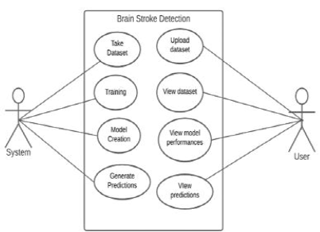

USECASE DIAGRAM

Slide 9
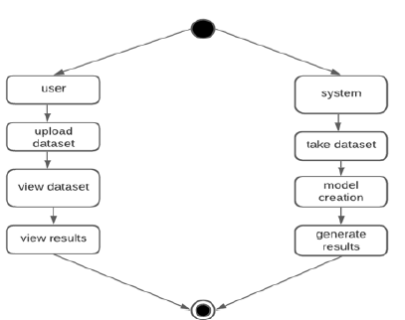
ACTIVITY DIAGRAM

Slide 10
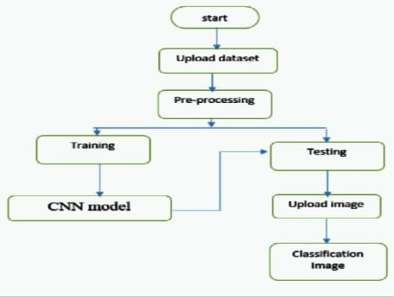
Dataflow DIAGRAM

Slide 11
ALGORITHMS
Data Acquisition
Data Preprocessing
Feature extraction and Selection
Model Training
Validation and Testing
Deployment
GUI / Web Interfaces

Slide 12
MODULES SPILT-UP
Data Collection and preprocessing
Feature extraction and selection
Model training and classification
Validation and Testing
GUI / Web interfaces

Slide 13
references
Innovations in Stroke Identification: A Machine Learning-Based Diagnostic Model Using Neuroimages.
Various research papers on AI-based medical diagnosis and stroke detection.

Slide 14
THANK YOU

